Slide 1
网络应用

Slide 2
Application architectures
Client-server (C/S)
Peer-to-peer (P2P)
Hybrid of C/S and P2P

Slide 3

Client-server architecture
server:
always-on host
permanent IP address
server farms for scaling
clients:
communicate with server
may be intermittently connected
may have dynamic IP addresses
do not communicate directly with each other
client/server

Slide 4
Pure P2P architecture
no always-on server
arbitrary end systems directly communicate
peers are intermittently connected and change IP addresses
peer-peer
Highly scalable but difficult to manage

Slide 5
Hybrid of client-server and P2P
Skype
voice-over-IP P2P application
centralized server: finding address of remote party:
client-client connection: direct (not through server)
Instant messaging
chatting between two users is P2P
centralized service: client presence detection/location
user registers its IP address with central server when it comes online
user contacts central server to find IP addresses of buddies

Slide 6
Processes communicating
Process: program running within a host.
within same host, two processes communicate using inter-process communication (defined by OS).
processes in different hosts communicate by exchanging messages
Client process: process that initiates communication
Server process: process that waits to be contacted
Note: applications with P2P architectures have client processes & server processes

Slide 7
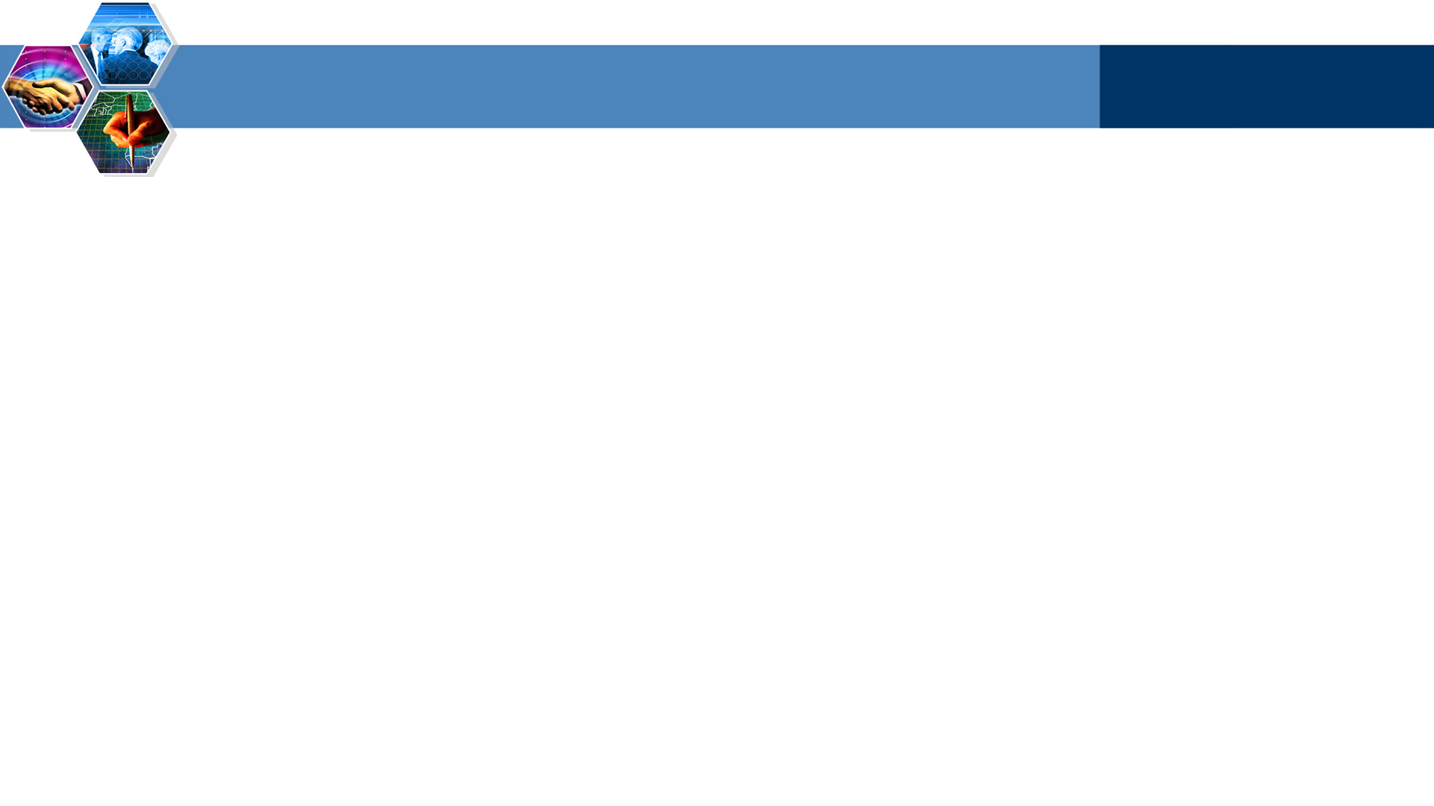
Sockets
process sends/receives messages to/from its socket
socket analogous to door
sending process shoves message out door
sending process relies on transport infrastructure on other side of door which brings message to socket at receiving process
host or
server
host or
server
controlled by
app developer
process
process
socket
socket
TCP with
buffers,
variables
TCP with
buffers,
variables
Internet
API: (1) choice of transport protocol; (2) ability to fix a few parameters (lots more on this later)
controlled
by OS

Slide 8
Addressing processes
to receive messages, process must have identifier
host device has unique 32-bit IP address
Q: does IP address of host suffice for identifying the process?

Slide 9
Addressing processes
to receive messages, process must have identifier
host device has unique 32-bit IP address
Q: does IP address of host on which process runs suffice for identifying the process?
A: No, many processes can be running on same host
identifier includes both IP address and port numbers associated with process on host.
Example port numbers:
HTTP server: 80
Mail server: 25
to send HTTP message to gaia.cs.umass.edu web server:
IP address: 128.119.245.12
Port number: 80
more shortly…

Slide 10
App-layer protocol defines
Types of messages exchanged,
e.g., request, response
Message syntax:
what fields in messages & how fields are delineated
Message semantics
meaning of information in fields
Rules for when and how processes send & respond to messages
Public-domain protocols:
defined in RFCs
allows for interoperability
e.g., HTTP, SMTP
Proprietary protocols:
e.g., Skype

Slide 11
What transport service does an app need?
Data loss
some apps (e.g., audio) can tolerate some loss
other apps (e.g., file transfer, telnet) require 100% reliable data transfer
Timing
some apps (e.g., Internet telephony, interactive games) require low delay to be “effective”
Throughput
some apps (e.g., multimedia) require minimum amount of throughput to be “effective”
other apps (“elastic apps”) make use of whatever throughput they get
Security
Encryption, data integrity, …

Slide 12
Transport service requirements of common apps
Application
file transfer
e-mail
Web documents
real-time audio/video
stored audio/video
interactive games
instant messaging
Data loss
no loss
no loss
no loss
loss-tolerant
loss-tolerant
loss-tolerant
no loss
Throughput
elastic
elastic
elastic
audio: 5kbps-1Mbps
video:10kbps-5Mbps
same as above
few kbps up
elastic
Time Sensitive
no
no
no
yes, 100’s msec
yes, few secs
yes, 100’s msec
yes and no

Slide 13
Internet transport protocols services
TCP service:
connection-oriented: setup required between client and server processes
reliable transport between sending and receiving process
flow control: sender won’t overwhelm receiver
congestion control: throttle sender when network overloaded
does not provide: timing, minimum throughput guarantees, security
UDP service:
unreliable data transfer between sending and receiving process
does not provide: connection setup, reliability, flow control, congestion control, timing, throughput guarantee, or security
Q: why bother? Why is there a UDP?

Slide 14
Internet apps: application, transport protocols
Application
layer protocol
SMTP [RFC 2821]
Telnet [RFC 854]
HTTP [RFC 2616]
FTP [RFC 959]
HTTP (eg Youtube), RTP [RFC 1889]
SIP, RTP, proprietary
(e.g., Skype)
Underlying
transport protocol
TCP
TCP
TCP
TCP
TCP or UDP
typically UDP
Application
e-mail
remote terminal access
Web
file transfer
streaming multimedia
Internet telephony

Slide 15

Summary
app architectures
app requirements

